Slide 1

Serverless Notifications with AWS SNS and SES
Discover scalable, efficient serverless notification systems.

Slide 2
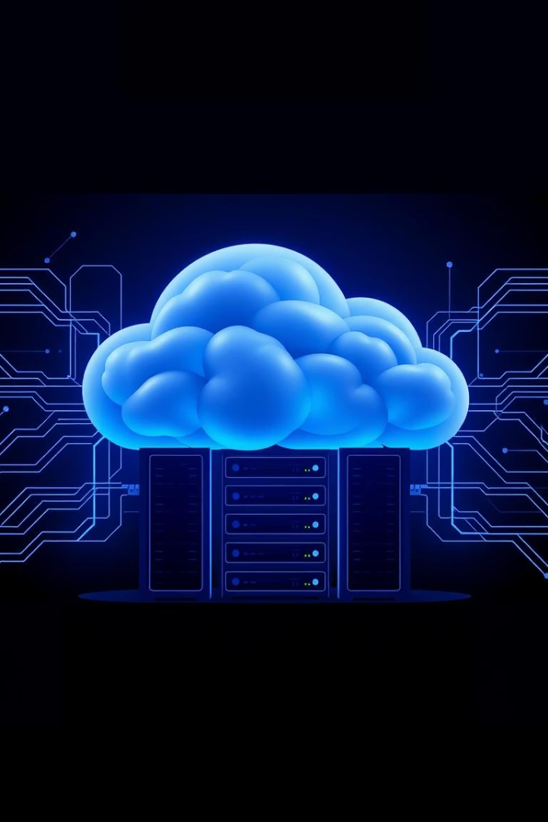
What is Serverless?
No servers to manage
Focus entirely on writing code, not infrastructure.
Pay-per-use pricing
Only pay for actual usage, enabling cost-effective scaling.
Event-driven architecture
Functions are triggered automatically by events in the system.
Key AWS services
Includes AWS Lambda, SNS, SES, and DynamoDB for serverless apps.

Slide 3
AWS SNS and SES: Core Components
AWS SNS
AWS SES
Pub/Sub messaging for fast distribution
Reliable email sending service
Fan-out to multiple subscribers
High deliverability with 99.99% uptime
Supports SMS, email, push notifications
Seamless integration with SNS topics

Slide 4





Architecture of a Serverless Notification System
Event Source
Examples: DynamoDB streams, API Gateway triggers events
AWS Lambda
Processes event data and formats messages
SNS Topic
Receives and distributes messages to subscribers
SES
Sends email notifications to end users
Subscribers
Email addresses, phone numbers, and app endpoints

Slide 5

Benefits of a Serverless Notification System
Scalability
Automatically handles large message volumes without hassle.
Cost Efficiency
Pay only for what you use, reducing wasted resources.
High Availability
AWS managed services ensure consistent uptime and reliability.
Simplified Management
No need to maintain or patch servers—focus on your app.

Slide 6
Setting Up the System: Step-by-Step
Create SNS Topic
Configure access policies for secure message publishing.
Verify SES Emails/Domains
Request production access to send emails at scale.
Create Lambda Function
Assign IAM role with SNS and SES permissions for messaging.
Configure Event Sources
Trigger Lambda via DynamoDB or API Gateway events.
Publish to SNS Topic
Messages get distributed to email and SMS subscribers.

Slide 7
Security Best Practices
IAM Roles
Encrypt Data
AWS Shield & GuardDuty
Grant least privilege access for all components.
Use AWS KMS to safeguard sensitive message content.
Protect system against DDoS attacks and threats.
Monitor Logs
SNS Access Policies
Use CloudWatch metrics and logs for early threat detection.
Strictly control who can publish to SNS topics.

